Slide 1
EXECUTIVE SUMMARY
DECODES LAB INTERNSHIP PROJECT
NASIR MARYAM

Slide 2
DATA SET OVERVIEW
The dataset contains sales transaction records spanning a period of three years. It includes information on products sold, quantity sold, unit price, total price, payment methods, order status, transaction dates, coupon codes and referral sources .
The data set was used to analyse sales performance and overall business performance

Slide 3
PROBLEM STATEMENT
How are sales performing across products, customers and time period
What are the ways to improve the overall sales of the business

Slide 4
METHODOLOGY
DATA CLEANING: data cleaning was performed in power Query. A total of 309 null values in the coupon code were replaced with “not available”. The Order ID column was checked for duplicates, none were found. Data integrity was verified across all fields. The total price and unit price columns were formatted to two decimal places with the appropriate currency symbol. Date field were standardized to a consistent format
EXPLORTAORY DATA ANALYSIS: calculated the key performance indicators, checked for patterns, trends and distribution with the use of pivot table
Built an interactive dashboard to visualize trends and insights
TOOL: Microsoft excel and postgreSQL

Slide 5
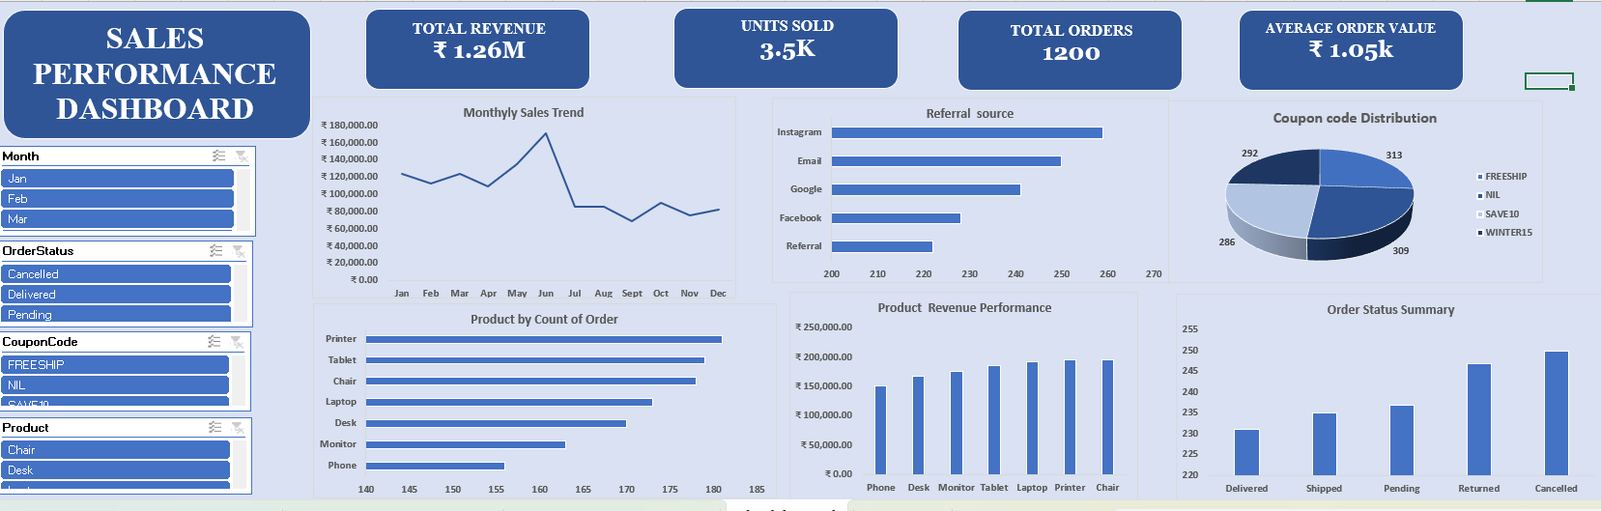
DASHBOARD OVERVIEW

Slide 6
KEY FINDINGS
Sales declining: 25.7% drop from 2023 to 2025 from 43.7% to 18.3% of total sales which could be due to lack of repeat customer strategy
Sales performance varied considerably across months. January recorded the highest monthly revenue at ₹124,313.23, while September recorded the lowest at ₹69,321.65, this could be because of reduced promotion activity in September.
Chair leads revenue: Chair accounts for 15.4% of total revenue (₹1,95,620.11). phones recorded the lowest sales figures among all product categories. Phone's low revenue despite reasonable order volume suggests low unit prices or heavy discounting
In terms of order volume, tablets were the most frequently ordered product, with 179 orders placed during the period.
High cancellation: A total of 231 orders were successfully delivered; however, 250 orders were cancelled which could be due to product-description mismatches, poor quality control, or slow delivery times frustrating customers.

Slide 7
KEY FINDINGS
Cart Abandonment The total number of items added to carts stood at 6,582, of which 3,535 items were actually sold, reflecting an overall cart-to-sale conversion rate of approximately 53.7%. Likely causes include unexpected shipping costs at checkout, a complicated checkout process, or customers browsing without intent to buy immediately.
Instagram was the leading referral source, generating 259 visits. The most widely used coupon code was FREESHIP, used 313 times, indicating strong customer responsiveness to free shipping incentives. No single promotion and referral source is outperforming significantly.
Online payment was the most preferred payment method, recorded in 258 transactions, while gift cards represented the least utilized payment option during the review period.

Slide 8
RECCOMMENDATION
Rekindle customer relationships through personalised email campaigns.
Improve product descriptions and images to set accurate expectations.
Follow up on the 237 pending and 235 shipped orders that have no resolution.
Mid-year clearance sale, flash sales or discounts can be done to boost the third and fourth quarter.
Phone pricing strategy should be reviewed, it may be underpriced relative to demand.
Promote tablets (highest order count at 179) more aggressively since customers already favour them.

Slide 9
RECCOMMENDATION
Set up automated cart abandonment reminders via email within 1–24 hours.
Display shipping costs upfront before checkout to avoid surprises.
Gift card campaign can be launched during festive or gifting seasons with a bonus credit incentive.

Slide 10
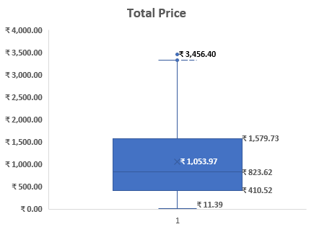
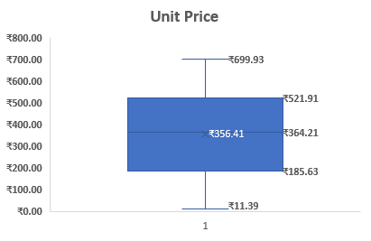
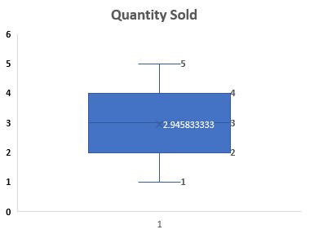
OUTLIER DISTRIBUTION
Total price: This is a right-skewed distribution, meaning while most orders fall within a moderate price range, a small number of very high-value transactions are pulling the average upward.
Quantity sold: near-zero skewness, The distribution is relatively compact and symmetrical, with no extreme outliers visible.
Unit price: this is a left-skewed distribution. The box shows a wide spread distribution, suggesting significant price variation across products.

